Slide 1
Predictive Modeling Of Customer Bookings Of British Airways
By
Koustav Dey

Slide 2
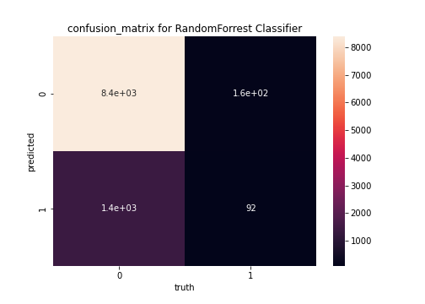
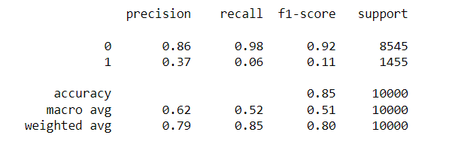
We made a prediction model out of 50000 data to predict if a customer books with British Airways.
Total records: 50000
Booking done: 7478
Booking canceled:42522
We tested on Random Forrest Classifier, Decision Tree , Gaussian NB and SVC .
Random Forrest Classifier had the highest score of 84.6% .
Fig : Classification Report

